Slide 1
Navigating a Crisis: Understanding Levels of Care & Treatment Options
Annie DiTiberio, LCSW
Family Consultant and Social Worker (Los Altos, CA)

Slide 2


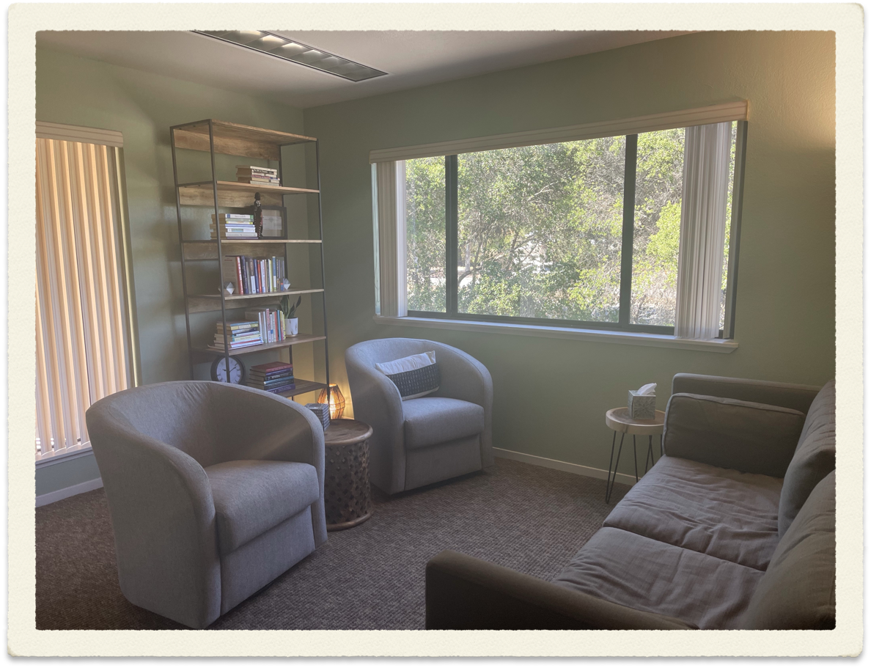


Crossroads Village Clinician & Manager
ED Psych Team Social Worker
Outpatient Clinic Manager
La Selva PHP/IOP Admissions Manager
Private Practice Social Worker

Slide 3

A Note to Providers
Please listen to family members! They have likely been managing this for years before they get to you.
Be respectful of releases of information, but also understand the intent of them. They are not there to prevent family from receiving help in times of crisis.
Develop Crisis Plans and ask to have those be shared with family members.
Prescribe PRNS just in case and educate parents on when they are appropriate

Slide 4
Staying Ahead of the Crisis
Consider having your loved one develop a WRAP (or you developing one): Wellness Recovery Action Plan
Develop a Psychiatric Advanced Directive with your loved one to help dictate steps in case of emergency/crisis
At a minimum, encourage your loved one (or yourself) to notice the early warning signs that things may be escalating.
Know what steps to take if things continue to worsen

Slide 5
First Steps (before emergent)
Call your loved one’s psychiatrist. Report on what you are seeing (observational data is best) and ask them to reach out to your loved one to set up an emergency session. Ask them to call you back to discuss what you can do (i.e encourage PRNs, encourage return to structure/routine, higher level of care)
Research higher levels of care and reach out about earliest admission (if your loved one has a social worker, call them to do this step)
Update AB1424 form to include current state
Reach out to supporters to help (therapist, friends). Be creative!

Slide 6
Next Steps (once emergent)
Consider calling a Mobile Crisis Team for de-escalation and evaluation
Reach out to psychiatrist again for help facilitating higher level of care
Consider Mental Health Urgent Care if your county has one
Offer a ride to an emergency for evaluation/hospitalization (or have a supporter take them)—only if this does not place anyone at risk
If police intervention is required, when calling 911 make sure to identify that the person has a mental health issue and request the Behavioral Health Team assist with intervention
Send the AB1424 to wherever they end up or provide to whatever team evaluates

Slide 7
Family Dynamics
There is often no one right way to respond to a loved one’s untreated or undertreated mental health. Allow your family members to be where they are.
Make sure other children in the family are allowed to have needs, and attempt to ensure the mental health issue does not dominate the family to the best of your ability
I believe it is a basic human right to feel safe in one’s own home. Consider this when making decisions about interventions and limits
Beware of reverse eviction

Slide 8
Levels of Care
Hospitalization (Locked)
Hospitalization (Voluntary)
Residential (always voluntary and unlocked)
Partial Hospitalization Program (PHP)/Intensive Outpatient Program (IOP)
Outpatient Therapy (psychiatry, therapy, group)

Slide 9
Private Insurance | Public Insurance
 | Long Term Locked
Involuntary Inpatient Hospitalization | Involuntary Inpatient Hospitalization
Voluntary Inpatient Hospitalization | XXXXX
Residential Treatment (2 weeks-??) | Crisis Residential Treatment (2-4 weeks)
Partial Hospitalization Program 5 days/week 4-6 hours/day | XXXXX
Intensive Outpatient Program 3 days/week 2-4 hours day | Day Rehabilitation Program
Psychiatry | Psychiatry
Therapy | Case Management/Therapy
Group Therapy | Group Therapy

Slide 10
What to Know WhenYour Loved One is Placed on a 5150
It is NOT a guarantee of hospitalization.
It can be dropped at any time during the 72 hour hold- you must let the psych team know if they are not welcome back home. STAY IN TOUCH WITH THE EVALUATION TEAM IN THE E.D.
If they have private insurance & there are no beds at the facility, it is likely they will be transferred to a different treatment facility with a bed. (This is not likely if they have Medical). YOU HAVE NO SAY OVER THIS
Attempt to stay in touch with the treating team wherever your loved one is and ask to be updated with changes and developments
You do NOT have to accept your loved one back home if you feel that is not safe until treatment has occurred

Slide 11
Once the 72 hours is up…
A decision must be made whether or not to extend to a 5250 hold (14 days). A hearing is held if your loved one wants to contest the hold (they will have a patients rights advocate who will represent them).
Again, the treating them can drop this hold at any point during the 14 days if they think they are no longer meeting criteria and can be safely discharged
A Riese hearing (aka “capacity hearing”) may also be held if the treating team wants to administer antipsychotic medication but your loved one is refusing.

Slide 12
Beyond 5250—Temporary Conservatorship
If your loved one still is deemed ill and not wanting treatment following the 14 day hold, the treating team often then files for temporary conservatorship. This allows them to continue treating them involuntarily at the hospital. YOU CAN ALSO REQUEST THEM TO FILE TEMPORARY CONSERVATORSHIP
If they are believed to need longer term locked stabilization they will likely put in an application to the county’s long term locked facility (only paid for if your loved one is on Medi-cal).

Slide 13
What to Do When Your Loved One is Hospitalized
Send the hospital where your loved one is admitted your AB1424 form as soon as possible & request a “goals conference” within the first few days
Make sure to get the contact information of the assigned social worker as soon as possible
Ask when visiting hours are (if you plan on visiting them)

Slide 14
Hospitalization is Stabilization, Not Treatment
In the goals conference make sure to discuss the discharge plan (which is where true treatment will happen)
It is right to expect a discharge plan to include one of the following:
  Transition to residential program
  Referral and first appointment to start a PHP/IOP
  Referral and first appointment to a psychiatrist/therapist
  Community resources to consider (groups, clubhouses, support groups)

Slide 15
Mobile Crisis Team Numbers
San Francisco County | 415-970-4000
San Mateo County | 650-573-0350
Santa Clara County | 1-800-704-0900 | TRUST Non-Urgent Response Team, call 988
Alameda County | (510) 981-5900
Marin County | 415-473-6392
Contra Costa County | (844) 844-5544

Slide 16

Follow me for more tips!
Social Media Accounts:
https://www.facebook.com/youneedasocialworker
https://www.instagram.com/youneedasocialworker/
Caption

Slide 17
Questions?
Annie DiTiberio, LCSW
1000 Fremont Ave. Suite 250A
Los Altos, CA
650-207-6694
anne.lcsw@gmail.com
www.annieditiberio.com
@youneedasocialworker

