Slide 1

Improving Emotional Intelligence in Children/Adults
Neil Nedley, M.D.

Slide 2

What is Emotional Intelligence
•Understanding your emotions and the emotions of others and responding to those emotions in a healthy way
•Our behaviors powerfully influence our thoughts and emotions
•But it’s our thoughts that cause our emotions and behavior

Slide 3

Aristotle
384 BC – 322 BC
•There are many ways to demonstrate anger, and anyone can become angry – that is easy,
•but to be angry with the right person,
•and to the right degree
•and at the right time,
•and for the right purpose,
•and in the right way
that is not within everyone’s power and that is not easy."

Slide 4
Emotional Intelligence
•Likely contributes more to successful and enjoyable living than I.Q.
•Since emotional intelligence is learned, rather than inherited, it can be improved.

Slide 5





5 Components of E.Q.
Knowing our emotions
Self awareness
Manage your emotions
Self Control
Recognize emotions in others
Empathy
Managing relationships with others
Social Intelligence
Motivating ourselves to reach goals
Motivation

Slide 6

Children with better self control
• More popular with other children
• Score higher on SAT scores 10 years later
• Displaying self-control by the age of 11 is highly correlated with successful employment throughout participants’ lives.
• Participants with low self-control experience 3 times as many months of being unemployed over 22 years, when compared to those with high self-control.
Psychological Science April 2015

Slide 7

Increasing E.Q. Can Effectively Prevent or Treat
• Depression.
• Phobias.
• Obsessive-compulsive disorder.
• Post-traumatic stress disorder.
• Anorexia.
• Bulimia.
• Addictions such as alcoholism
• Violence against family and others
• Relationship break ups

Slide 8

Increased E.Q. also helps “normal people”
• Think clearer
• Communicate more effectively
• Fosters unity in group settings
• Reduces polarizing statements
• Promotes happier life
• All of this is accomplished without compromise or sacrificing the truth

Slide 9

Facts about mental disorders in U.S. children
ADHD, anxiety problems, behavior problems, and depression are the most commonly diagnosed mental disorders in children.

Slide 10





Estimates for ever having a diagnosis among children aged 3-17 years, in 2016-19
ADHD 9.8% (approximately 6.0 million)
Anxiety 9.4% (approximately 5.8 million)
Behavior problems 8.9% (approximately 5.5 million)
Depression 4.4% (approximately 2.7 million)
Data and Statistics on Children’s Mental Health CDC 2022
Bitsko RH, Claussen AH, Lichtstein J, Black LJ, Everett Jones S, Danielson MD, Hoenig JM, Davis Jack SP, Brody DJ, Gyawali S, Maenner MM, Warner M, Holland KM, Perou R, Crosby AE, Blumberg SJ, Avenevoli S, Kaminski JW, Ghandour RM. Surveillance of Children’s Mental Health – United States, 2013 – 2019 MMWR, , 2022 / 71(Suppl-2);1–42

Slide 11

Depression and anxiety have increased over time
“Ever having been diagnosed with either anxiety or depression” among children aged 6–17 years increased from 5.4% in 2003 to 8% in 2007 and to 8.4% in 2011–2012
Bitsko RH, Holbrook JR, Ghandour RM, Blumberg SJ, Visser SN, Perou R, Walkup J. Epidemiology and impact of healthcare provider diagnosed anxiety and depression among US children. Journal of Developmental and Behavioral Pediatrics. Published online before print April 24, 2018. as quoted by Data and Statistics on Children’s Mental Health CDC 2022

Slide 12
15.1% had a major depressive episode.
36.7% had persistent feelings of sadness or hopelessness.
4.1% had a substance use disorder.
1.6% had an alcohol use disorder.
Among adolescents aged 12-17 years in 2018-2019 reporting on the past year:
Data and Statistics on Children’s Mental Health CDC 2022
Bitsko RH, Claussen AH, Lichtstein J, Black LJ, Everett Jones S, Danielson MD, Hoenig JM, Davis Jack SP, Brody DJ, Gyawali S, Maenner MM, Warner M, Holland KM, Perou R, Crosby AE, Blumberg SJ, Avenevoli S, Kaminski JW, Ghandour RM. Surveillance of Children’s Mental Health – United States, 2013 – 2019 MMWR, , 2022 / 71(Suppl-2);1–42

Slide 13
3.2% had an illicit drug use disorder.
18.8% seriously considered attempting suicide.
15.7% made a suicide plan.
8.9% attempted suicide.
2.5% made a suicide attempt requiring medical treatment.
Among adolescents aged 12-17 years in 2018-2019 reporting on the past year:
Data and Statistics on Children’s Mental Health CDC 2022
Bitsko RH, Claussen AH, Lichtstein J, Black LJ, Everett Jones S, Danielson MD, Hoenig JM, Davis Jack SP, Brody DJ, Gyawali S, Maenner MM, Warner M, Holland KM, Perou R, Crosby AE, Blumberg SJ, Avenevoli S, Kaminski JW, Ghandour RM. Surveillance of Children’s Mental Health – United States, 2013 – 2019 MMWR, , 2022 / 71(Suppl-2);1–42

Slide 14

Mental, behavioral, and developmental disorders begin in early childhood
  1 in 6 U.S. children aged 2–8 years (17.4%) had a diagnosed mental, behavioral, or developmental disorder.
  Diagnoses of ADHD, anxiety, and depression become more common with increased age.
Cree RA, Bitsko RH, Robinson LR, Holbrook JR, Danielson ML, Smith DS, Kaminski JW, Kenney MK, Peacock G. Health care, family, and community factors associated with mental, behavioral, and developmental disorders and poverty among children aged 2–8 years — United States, 2016. MMWR, 2018;67(5):1377-1383, as quoted by Data and Statistics on Children’s Mental Health CDC 2022

Slide 15
15
10
Depression, Anxiety, Behavior Disorders by Age
5
0
3-5
6-11
12-17
3-5
6-11
12-17
3-5
6-11
12-17
Depression
Anxiety
Behavior Disorders

Slide 16

When did mental illness begin to skyrocket?
• 2012
• ½ of Americans in 2012 owned a smartphone
• Increased further after that

Slide 17

There were 2 pandemics in 2020 to 2022
Mental Illness
COVID

Slide 18

Monitoring the Future
• A major longitudinal study looked at the lives of more than a million young people.
• Teens who spend large amounts of time glued to phone and computer screens are markedly less happy than those who prefer “real-world” activities and interactions.
• Social media, texting, video chatting, and multiplatform video games were all associated with decreased happiness.

Slide 19

Monitoring the Future
• Youth who invested more time in non-screen activities, such as playing sports, reading newspapers, and engaging in face-to-face social interactions were significantly happier.
• The life satisfaction, self-worth, and happiness of young people in the US plummeted after 2012, the year when the proportion of Americans owning a smartphone rose above 50%.

Slide 20

Measuring happiness
The happiest teenagers were those who used digital media less than an hour a day. After a daily hour of screen time, levels of unhappiness rose steadily.

Slide 21

Social Media Also Makes
Us Anti-Social
• We are attracted to social media as a means of connection, but soon virtually everyone ends up comparing far more than they connect.
• We compare via a false world that looks true.

Slide 22

Time Spent with Media Devices Cannot Be Regained
• Media devices waste a lot of time, sometimes hours each day.
• They keep us from doing healthy activities, spending time with our families, and engaging in productive work.
• Children may learn more from devices than from their parents and tend to trust their devices over their parents.
• When parents use devices, children tend to use theirs even more.
• Allowing kids free access to smartphones gives them access to the creeps of the world.

Slide 23

Digital Sabbath
• One of the keys to success is a “digital Sabbath” every day.
• A digital Sabbath is a time when adults and kids are not distracted by devices.
• During that time, engage in focused learning or healthy activities.

Slide 24

The Benefits of an E-Fast

Slide 25

Six Weeks with No Screen Time
• Remove phone applications.
• Turn off notifications.
• After a six-week e-fast, you can spend less than an hour a day on a device outside of work and not within an hour of going to bed.

Slide 26
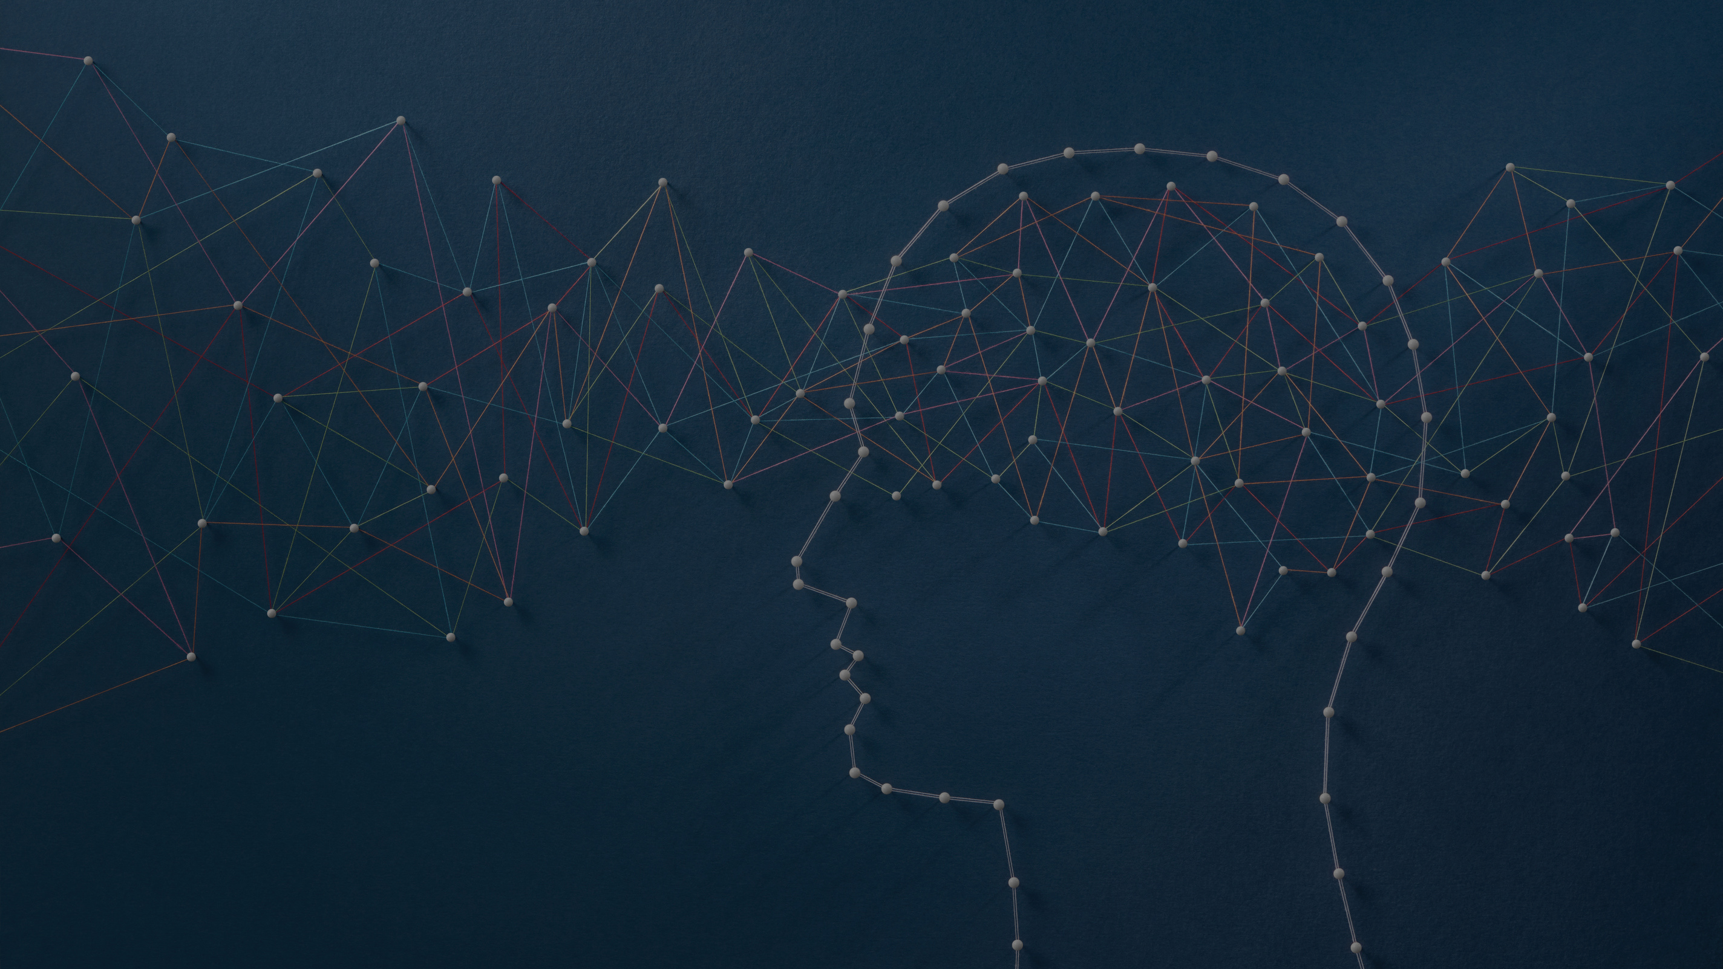
Behaviors That Improve E.Q.
Solutions

Slide 27


Physical exercise to improve fitness
• Improves neurotransmitter receptors and release
• Improves cognitive function
• Mood
• Memory

Slide 28
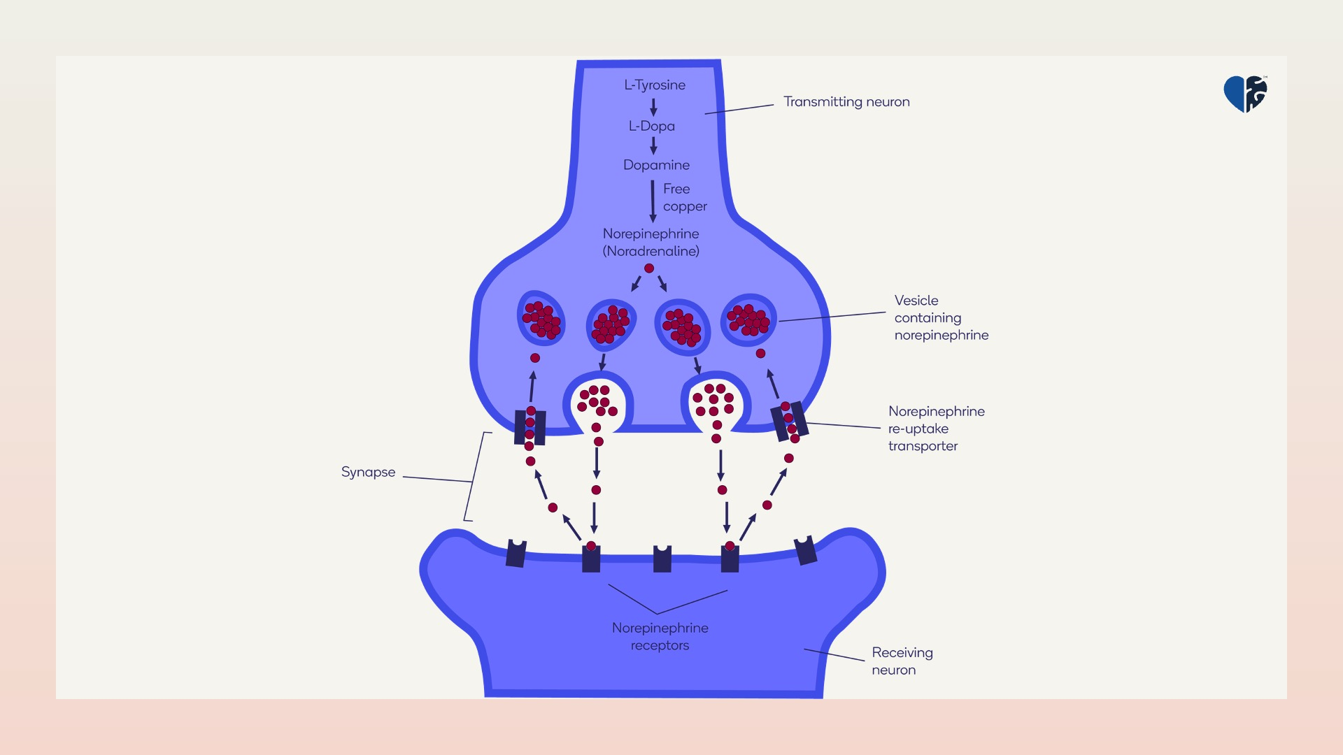

Slide 29



Nutrition Hits
  Nutrition is possibly the most overlooked cause of diminished mental power, depression, or anxiety
  Can have profound effects
  Once a nutrition change is adopted, it takes 7–10 days to begin noticing a difference
  Gradual improvement continues with maximum effects taking place 6 months after a consistent change has been made

Slide 30
Nutritional Issues and Lack of Mental Power
  Insufficient dietary tryptophan
  Insufficient dietary tyrosine
  Excess cholesterol
  Excess arachidonic acid
  Insufficient dietary folate
  Insufficient iron
  Low omega-3 fatty acid intake
  Insufficient magnesium
  Insufficient zinc
  Insufficient thiamine, B₆ (pyridoxal phosphate), choline, and resveratrol

Slide 31
Nutrition Hit: Tryptophan

Slide 32
Nutritional Hit: Tryptophan
  Dietary tryptophan does not necessarily equal brain tryptophan
  Insufficient brain tryptophan
  Tryptophan is converted to serotonin, melatonin, and niacin
  It is the least abundant amino acid in the diet
  The conversion of tryptophan to 5-HTP is inhibited by stress, insulin resistance, magnesium or vitamin B6 deficiency, lack of light, and increasing age
Notes:
Niacin: vitamin B3

Slide 33

Tryptophan Supplementation Improves
General mood, and it can decrease quarrelsome behaviors and increase agreeable behaviors
Notes:
relative to placebo
Tryptophan recommendation: 1,000-4000 mg daily maximum
Sounds like a pretty good relationship builder right there

Slide 34
Genetic Makeup
Childhood Experiences
Current emotional support
Physical Conditions - Such as lack of sleep, poor nutrition, illness
Influences on E.Q.
For many, these factors are of less significance when compared to the next slide

Slide 35
Our Beliefs
Our evaluations of events
The way we think about problems
Our silent self-talk.
The Major Influence on E.Q.
Our emotions are largely controlled by

Slide 36

Thoughts and Feelings
Your feelings result from the messages you give yourself.
Your thoughts have much more to do with how you feel, than what is actually happening in your life.

Slide 37

The A-B-C of CBT
A—Activating Event, C—Emotional Consequence
A
C

Slide 38

Crooked Thinking
• Also called A—C Thinking
• Believing that we have little or no ability to influence our feelings and that events and situations directly cause our emotions and behavior.

Slide 39
The A-B-C of CBT
A—Activating event, B—Belief, C—Emotional Consequence
A
B
C

Slide 40

Pacific Judicial Council
• Heard of emotional intelligence by those who have been attending the emotional intelligence annual summits at Weimar University
• Chief Judge Frances Gatewood invitation to speak to educators, legislators, and executive and judicial branches of government
• 9th circuit headquartered in San Fran asks to develop pilot curriculum

Slide 41

Since Emotional Intelligence is Learned
•What about teaching it in pre-K through grade 12 as we would math or social studies?
•Would best be comprehensive, interesting, interactive, and engaging

Slide 42

EQ Curriculum
Pilot in grades 2, 5, and 9

Slide 43
Four Units
• Unit 1, Brain Anatomy and Physiology
• Unit 2, Comprehensive Brain Health
• Unit 3, Emotional Intelligence
• Unit 4, Recognizing and correcting “Thinking Errors”

Slide 44
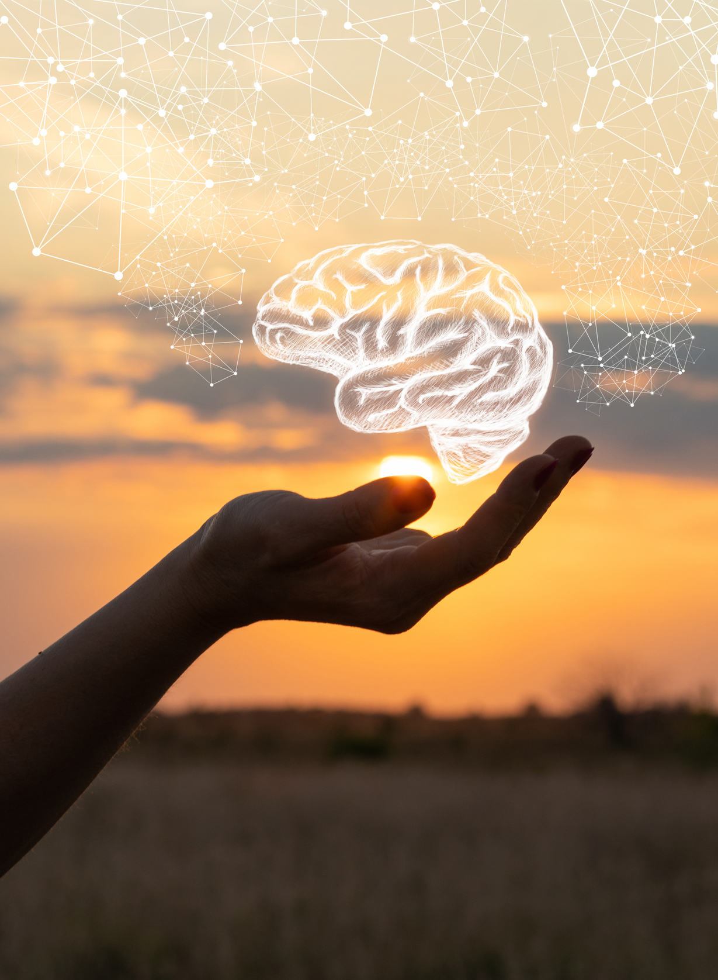
How Important is it to Prioritize the Health of Your Brain?
Up substantially in ten weeks
Notes:
• Prior to teaching this class, never had students be upset that the class was over
• Now, “Teacher, the class is over already?”
• Prior to teaching this class never had students ask what they were going to learn tomorrow?
• Now, ”Teacher, what are we going to learn tomorrow”
• When course began, “Teacher our music is not healthy for us? Is that really music?”
• “Teacher how come you are not playing that music that helps us, we like that music”
• ”Teaching this class has saved my marriage”
• “This class is more important than religion”
• “Religion teaches what we must do before we die, to go to heaven”
• “This course teaches us how we can have heaven on earth, right now.”
• Parents are excited about the changes they are seeing in their own children
• Children are helping with the work at home
• Children are expressing gratitude
• Children are controlling their emotions better

Slide 45

Students
• Like the applications and crafts
• Enjoyed the gratitude exercises
• Started to like healthy music
• Physically exercising more
• Eating healthier
• Enjoy analyzing their thoughts for distortions
• Able to manage their emotions, less anger, better behaviors

Slide 46
These changes took place in just 10 weeks
• One quarter
• Can you develop a pre-K to grade 12 curriculum for every year?
• Hope to have it ready for August
• Public schools in 10 Pacific Islands mandating the teaching of NEWSTAR and truthful, helpful thoughts
Notes:
• Like the applications and crafts
• Enjoyed the gratitude exercises
• Started to like healthy music
• Physically exercising more
• Eating healthier
• Enjoy analyzing their thoughts for distortions
• Able to manage their emotions, less anger, better behaviors

Slide 47
Nedley, N., & Ramirez, F. E. (November, 2016). “Nedley Depression Hit Hypothesis Identifying Depression and Its Causes.” American Journal of Lifestyle Medicine, 1559827614550779.
Data and Statistics on Children’s Mental Health CDC 2022 Bitsko RH, Claussen AH, Lichtstein J, Black LJ, Everett Jones S, Danielson MD, Hoenig JM, Davis Jack SP, Brody DJ, Gyawali S, Maenner MM, Warner M, Holland KM, Perou R, Crosby AE, Blumberg SJ, Avenevoli S, Kaminski JW, Ghandour RM. Surveillance of Children’s Mental Health – United States, 2013 – 2019 MMWR, , 2022 / 71(Suppl-2);1–42 2) Lamb ME. The history of research on father involvement: An overview. Marriage and Family Review. 2000;29:23–42. 3)Pauline Emmett Journal of Epidemiology and Community Health 2011"
Notes:
• Like the applications and crafts
• Enjoyed the gratitude exercises
• Started to like healthy music
• Physically exercising more
• Eating healthier
• Enjoy analyzing their thoughts for distortions
• Able to manage their emotions, less anger, better behaviors

